Slide 1
VFB Pipeline 2: Container architecture
* Arrows are in the direction of data/information flow, not dependency
Legend
vfb-kb
data-pipeline
Usual kb-image
Incl Neo2OWL plugin
vfb-validate
vfb-solr
Server/service
validates
Validates KB schema (basic checks)
Docker volume
load
neo4j2owl:exportOWL()
vfb-dumps
wget
Creates custom RDF/json dumps for each service
vfb-update-prod
Preprocess
Load into neo4j
vfb-prod
deposit
vol
vfb-collect-data
deposit
Pulls raw data from various sources
Dumps RDF, gzip
curl:SPARQL
load
vol
yyz1989/rdf4j (vfb-triplestore)
vfb-pipeline-updatetriplestore
vfb-owlery
read
Fires up triple store from scratch
Load RDF dumps into triplestore
load

Slide 2
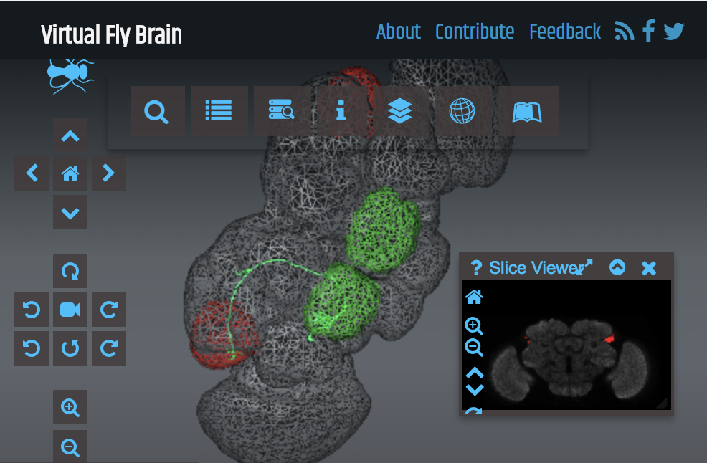
Pipeline - aims
Neo4j prod:
Graphs;
Basic metadata
FlyBase
Geppetto
CATMAID
(connectomics)
Integration layer
= triple store
SOLR:
Autocomplete search
URI
sync
annotation
ontologies
OWL:
Queries
VFB annotation
(KB)
URI
sync
New entities
NBLAST
Same? Nico says definitely not.
Image files

Slide 3
NBLAST
URI sync
URI sync
TSV
KB
Production Deploy
dipper
e.G Materialisation, Most specific classification

Slide 4
VFB Curator
URI sync
URI sync
…
Flybase
KB
Ingest, Validation
REST API
dipper
Triplestore Post-processing,
e.g Materialisation, Most specific classification

Slide 5
DATARAW
DATA
Collect all relevant sources in DATARAW
Run dipper
Copy files to DATARAW
Copy VFB.owl and others to DATARAW
Preprocess data in DATARAW
Convert all files to RDF/XML and gzip
Verify form
COPY to DATA
Set up Triple store
Create fresh local triple store
Load all files in DATA and feed into triplestore

Slide 6
KB Schema
FB:pub
Individual
Feature
Object Property
rdf:type
Annotation Property
Template
BiologicalEntity
Feature
Cluster
Class
has_neo_type
rdf:type
any
rdf:type
member_of
OWL relation
AnatomicalEntity
has_member
Channel
hasDbXref
Site
in_register_with
depicts
rdf:type
has_source
Image
Image
in_register_with
DataSet
has_reference
Is_specified_output_of
has_license
License
ImagingMethod

Slide 7
Neo2OWL
Individual I
For all attributes a in I
If annotationPropertyWithSafeLabelExists(a) → annotationAssertion(I.iri,iri(a),I.x)}
Else ignore (i.e. assume it is taken care of by other means or is irrelevant?)
For all labels t in I
If (classWithSafeLabelExists(t) → owlClassAssertion(I,iri(t))
Else annotationAssertion(I,vfb:neoconvenience,iri(t))
Class C
annotationAssertion(C.iri,obo:deprecated,C.isObsolete)
Annotation Property A
annotationAssertion(A.iri, vfb:safeLabel, A.safeLabel)
Object Property P
annotationAssertion(P.iri, vfb:safeLabel, P.safeLabel)
Edge E: (x)-[R]-(y)
If R annotation property: OWLAnnotation(x.iri,R,y.iri)
If x,y individuals:
OWLObjectPropertyAssertion(x,R,y)
If x individual, y class:
ClassAssertion(x,R some y)
If x class, y class
SubClassOf(x,R some y)
If x class, y individual
SubClassOf(x,R value y)
HOW TO DEAL WITH PROVENANCE?

Slide 8
OWL2Neo
For annotations <I,R,v> on Individual I
If isEntity(v) → (i)-[safeForm(R)]-(v)
Else (i:safeForm(R)=v)
For object property assertions <I,R,I2>
(i)-[safeForm(R)]-(v)
For a:R some C
For a:R some {a} / R value a
For C sub R some D
For C sub D
For C sub R some {a} / R value a
Axiom annotations will be done as edge attributes:
shortForm(AP):
Individuals I
Node(iri=I.iri, NamedIndividual, safeForm(OP))
Annotation Properties AP
Node(AP.iri, :AnnotationProperty, safeForm(OP), …)
Object Property OP
Node(OP.iri, :ObjectProperty, safeForm(OP), …)
Class C
Node(C.iri,:Class, safeForm(Class),…)

Slide 9
Create Individual Nodes
Create Class Nodes
Create ObjectProperty Nodes
Create AnnotationProperty Nodes
Create entity annotations
To other entities
To literals
Create relationships
OPAssertions
I -> I
Existential restrictions
I -> C
C -> I
C -> C

Slide 10
Semantics of Template?
We need an extra rule for class labels that have no refered classes

Slide 11
VFB KB
Stores:
Annotated images:
Entities depicted = Typed OWL individuals
Image individuals have basic typing + link to templates registered to. Registration edge contains file links & some reg specific metadata
Images may be from light microscopy, EM reconstruction, annotated schematics
Does not store
Connectomic data
General assertions about expression/phenotype
Axioms from imported ontologies apart from annotation axioms for label, iri, short_form – recorded as node attributes.

